Slide 1
Optical resonators
Free space and guided optics

Slide 2
Basic properties of optical resonators
Part 1

Slide 3
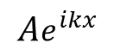
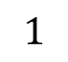
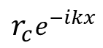
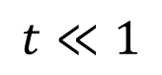
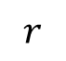
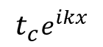
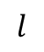
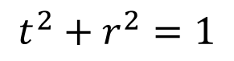
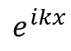
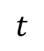
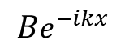
Basic intuition: a one-dimensional model
$$l$$
$$e^{ikx}$$
$$Ae^{ikx}$$
$$t_{c}e^{ikx}$$
$$r_{c}e^{−ikx}$$
$$Be^{−ikx}$$
Mirror
$$1$$
$$t^{2}+r^{2}=1$$
$$t$$
$$r$$
$$t≪1$$
HR coating
AR coating
Ignore for now the transverse shape of the beam (assume it evolves slowly enough)

Slide 4
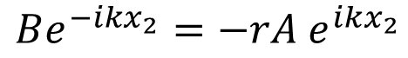
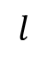
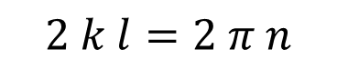
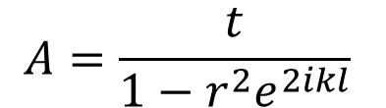
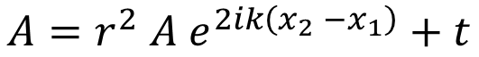
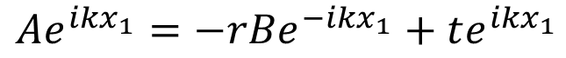
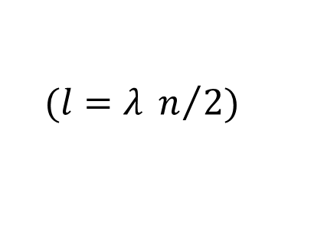
Basic intuition: a one-dimensional model
$$l$$
$$e^{ikx}$$
$$Ae^{ikx}$$
$$t_{c}e^{ikx}$$
$$r_{c}e^{−ikx}$$
$$Be^{−ikx}$$
Boundary conditions:
$$l$$
$$Be^{−ikx_{2}}=−rA e^{ikx_{2}}$$
$$A=r^{2} A e^{2ik\left(x_{2} −x_{1}\right)}+t$$
$$Ae^{ikx_{1}}=−rBe^{−ikx_{1}}+te^{ikx_{1}}$$
$$A=\frac{t}{1−r^{2}e^{2ikl}}$$
Resonance condition:
$$2 k l=2 π n$$
$$(l=λ n/{2)}$$

Slide 5
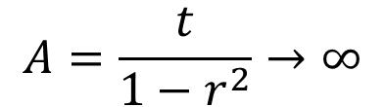
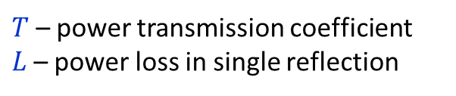
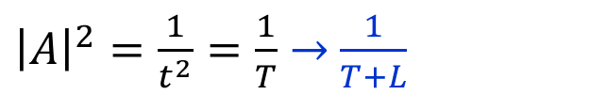
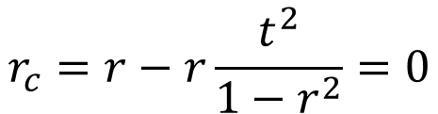
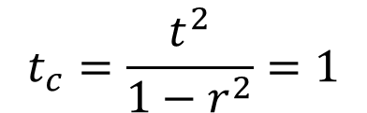
Basic intuition: a one-dimensional model
$$l$$
$$e^{ikx}$$
$$Ae^{ikx}$$
$$t_{c}e^{ikx}$$
$$r_{c}e^{−ikx}$$
$$Be^{−ikx}$$
On resonance:
On resonance the cavity becomes transparent!
(nothing is reflected back)
$$A=\frac{t}{1−r^{2}}→∞$$
$$t_{c}=\frac{t^{2}}{1−r^{2}}=1$$
Cavity power enhancement factor:
${\left|A\right|}^{2}=\frac{1}{t^{2}}=\frac{1}{T}→$ $\frac{1}{T+L}$
$$r_{c}=r−r\frac{t^{2}}{1−r^{2}}=0$$
$T$ – power transmission coefficient
$L$– power loss in single reflection

Slide 6
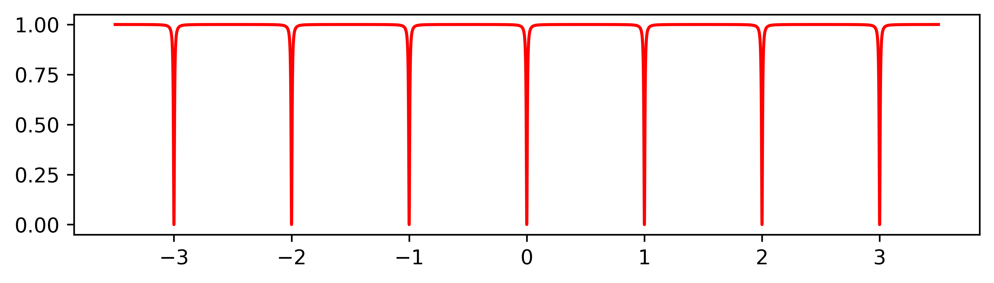
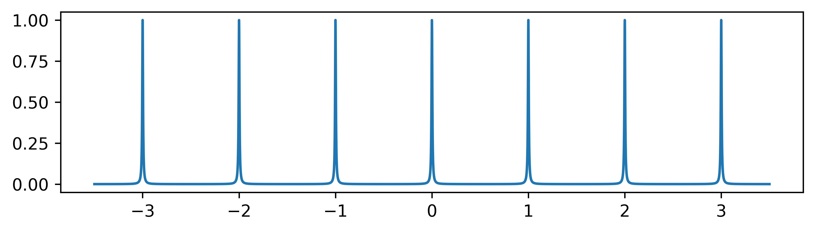
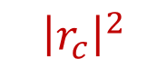
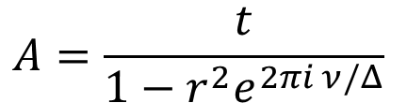
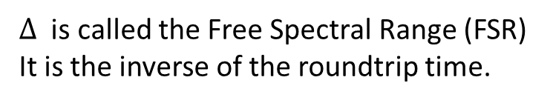
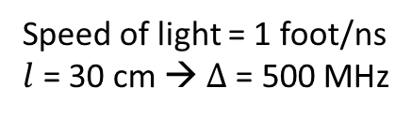
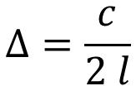
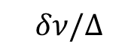
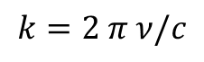
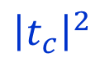
Longitudinal modes and FSR
$$k=2 π ν/c$$
$$A=\frac{t}{1−r^{2}e^{2πi ν/Δ}}$$
$$Δ=\frac{c}{2 l}$$
$Δ$ is called the Free Spectral Range (FSR)
It is the inverse of the roundtrip time.
Longitudinal modes
$${\left|r_{c}\right|}^{2}$$
Speed of light = 1 foot/ns
$l$ = 30 cm → $Δ$= 500 MHz
$${\left|t_{c}\right|}^{2}$$
Frequency detuning
$$δν/Δ$$

Slide 7
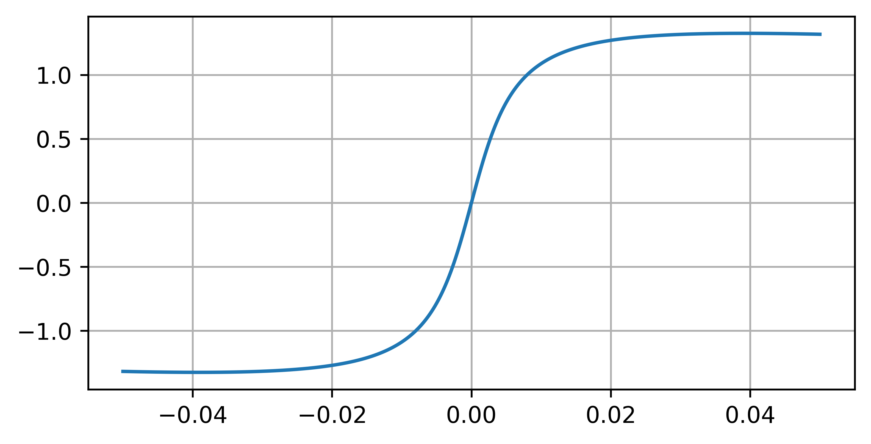
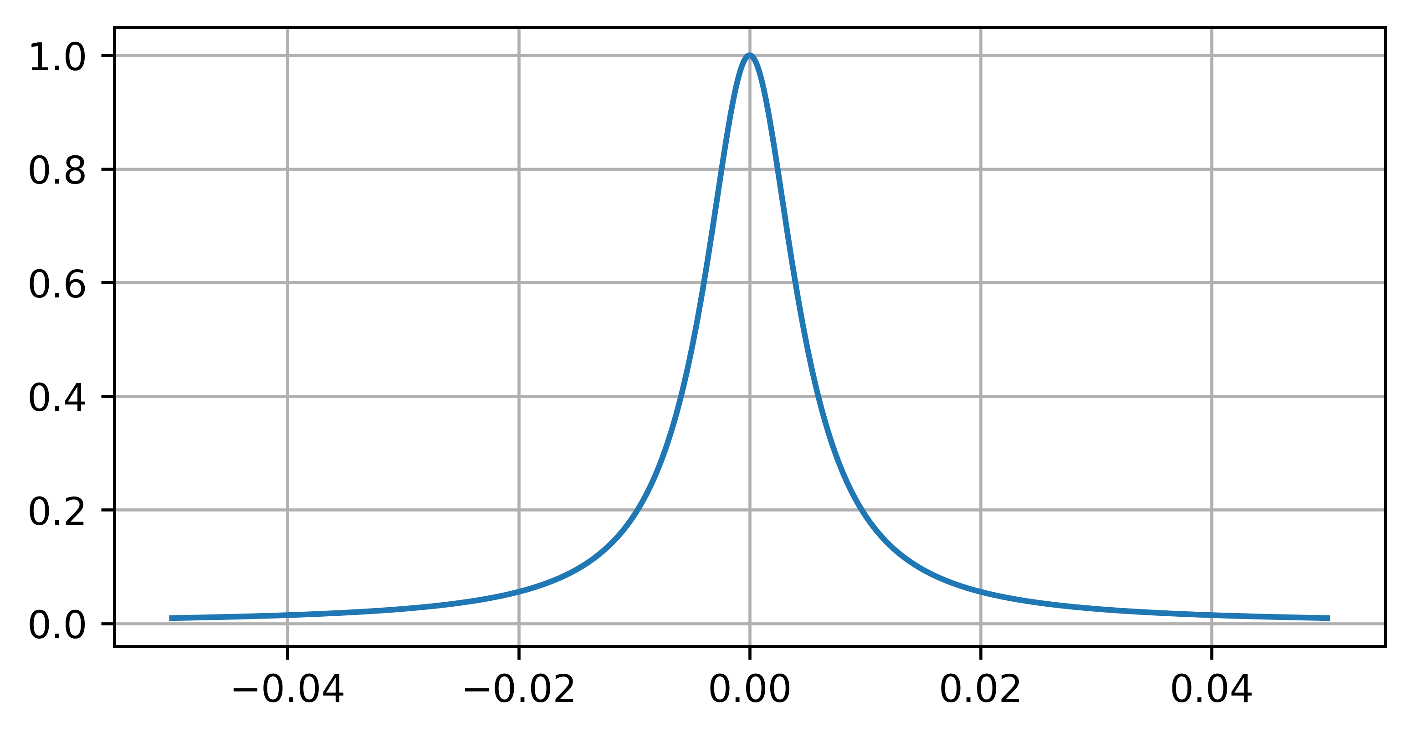
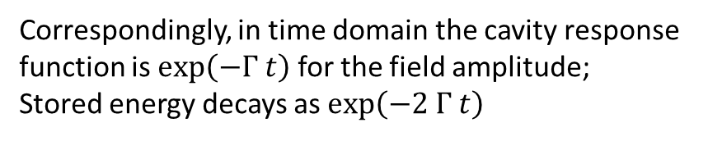
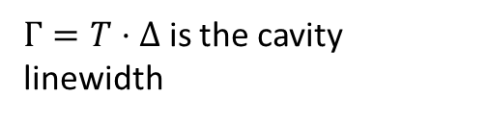
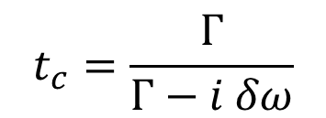
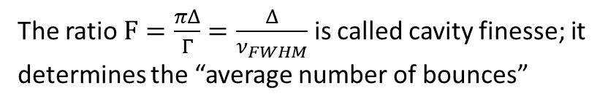
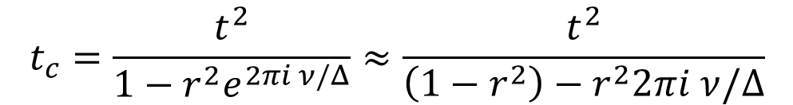
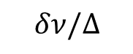
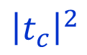
Cavity line shape
phase
$$t_{c}=\frac{t^{2}}{1−r^{2}e^{2πi ν/Δ}}≈\frac{t^{2}}{\left(1−r^{2}\right)−r^{2}2πi ν/Δ}$$
Cavity line shape is Lorentzian
$$t_{c}=\frac{Γ}{Γ−i δω}$$
T=0.03
$Γ=T⋅Δ$ is the cavity linewidth
$${\left|t_{c}\right|}^{2}$$
Correspondingly, in time domain the cavity response function is $exp\left(−Γ t\right)$ for the field amplitude;
Stored energy decays as $exp\left(−2 Γ t\right)$
The decay time $τ= \frac{1}{2 Γ}=\frac{l}{c T}$ is the photon lifetime in the cavity
The ratio $F=\frac{πΔ}{Γ}=\frac{Δ}{ν_{FWHM}}$ is called cavity finesse; it determines the “average number of bounces”
Frequency detuning
$$δν/Δ$$

Slide 8
Transverse modes & resonator stability
Part 2

Slide 9
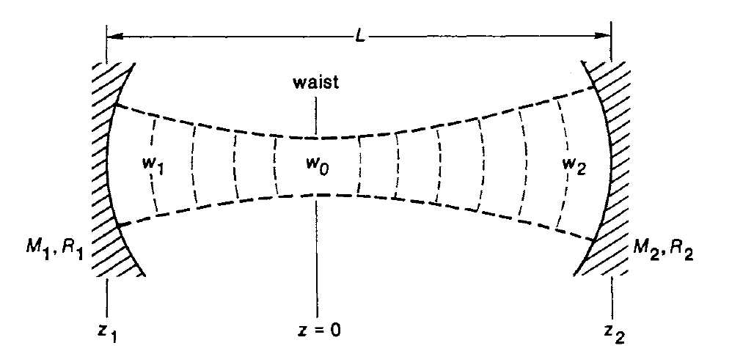
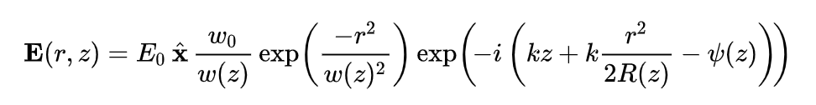
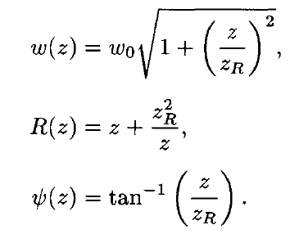
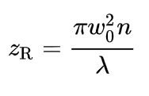
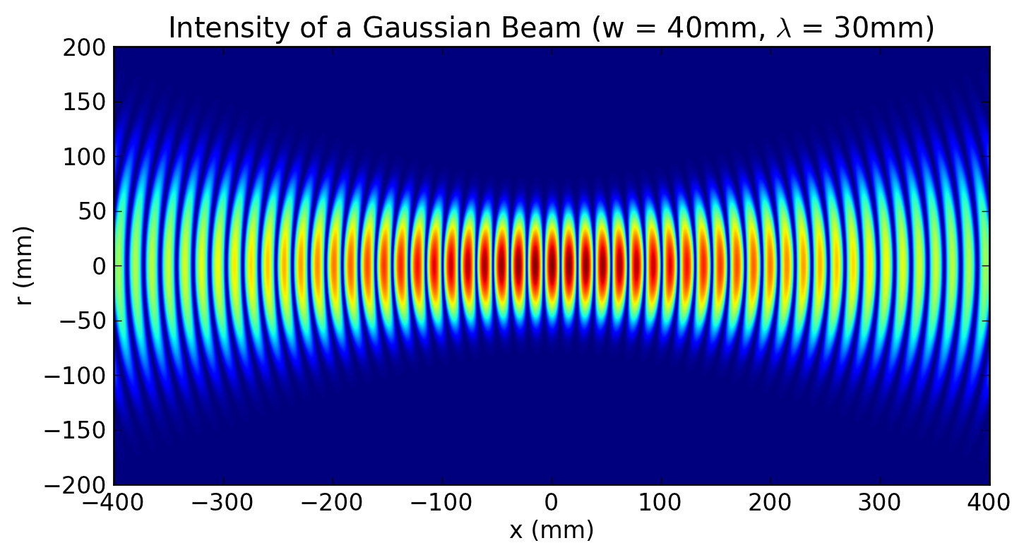
Gaussian beams and cavities
Reference:
Siegman, LASERS
Gaussian beams:
Remain self-similar through paraxial propagation and focusing
Wavefronts are spherical, match spherical mirrors
Diffraction balances focusing

Slide 10
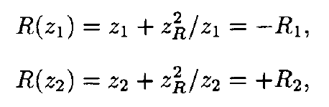
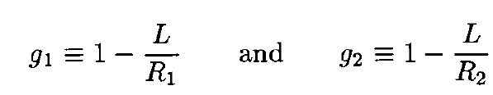
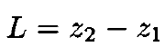







Matching Gaussian beams to mirrors
Convenient dimensionless parameters:
Solution exists only when
$$0< g_{1}g_{2}<1$$
Resonator stability from ABCD matrices is pg. 626 (600) in Siegman

Slide 11




Resonator stability
Diffraction balances focusing
Degenerate resonators correspond to imaging conditions
Case of $R_{1}=$ $R_{2}$

Slide 12


Transverse modes
Generalized Gaussian modes:
Hermite-Gauss functions (eigenfunctions of the harmonic oscillator) are also self-similar under propagation and focusing
Hermite polynomials
These functions form a complete set – any input field can be decomposed in those
N = l + m
Note that the Gouy phase is multiplied by an integer factor!

Slide 13


Gauss-Hermite and Gauss-Laguerre modes
Gaussian beams system in two transverse dimensions
X-Y variable separation
product of solutions along X and Y
R-φ: variable separation in cylindrical coordinates
defined “orbital angular momentum”

Slide 14






Transverse mode spectral properties
2 lines (2x degenerate)
3 lines (3x degenerate)
4 lines (4x degenerate)

Slide 15

Transverse mode spectral properties
Anthony E. Siegman, LASERS chapter 19.3

Slide 16
Part 2. Resonator applications and experiments

Slide 17



Frequency stabilization cavities
stablelasers.com
Spacer made of low CTE glass (ULE, Zerodur)
Low-loss coatings produced by ion beam sputtering
Typical coating materials: layers of Tantala (high index) and Silica (low index)
NIST 2012

Slide 18


LIGO: Laser interferometer gravitational wave observatory
LIGO Caltech website

Slide 19

LIGO: Laser interferometer gravitational wave observatory
Adding a few cavities helps with sensitivity
Drever, R.W. P., 1983, “Interferometric detectors for gravitational radiation,” Gravitational Radiation, NATO Advanced Physics Institute, Les Houches, edited by N. Deruelle and T. Piran (North-Holland Publishing, Amsterdam), p. 321.

Slide 20



Recycling the signal
Reflecting most of your signal back into the interferometer actually increases the signal!

Slide 21


Cavities galore

Slide 22



Optical spring
Dynamic instability
“Detuning a cavity to higher frequencies (blue detuning)
gives rise to a restoring force, known as an optical spring
[10–12], as well as an antidamping force due to the delay
in the cavity response time. Conversely, detuning to lower
frequencies (red detuning) gives rise to optical damping
[13] along with an antirestoring force.”
“The effective Young’s modulus of this mode with area A of
the beam spot (1.5 mm2) and length L =0.9 m of the
cavity, is given by E KL=A 1.2 TPa, stiffer than any known material (but also with very small breaking strength).”

Slide 23





Cooperativity and Purcell effect
A quantum system placed in a cavity can interact coherently with the EM field in the cavity mode
Emission rate into the cavity mode is enhanced on resonance (Purcell effect) by a factor that is called cooperativity
Suppressed emission into cavity mode off-resonance
If cooperativity is high, the quantum system is predominantly interacting with the cavity mode
H. MABUCHI AND A. C. DOHERTY, Science (2002)
Interaction:
Cooperativity:
Purcell factor:
Lukin et al, Science (2018)

Slide 24



Microresonators
Barak Dayan and Jeff Kimble, Science (2008)

Slide 25


Microresonators
Strong four-wave mixing in the resonator generates a series of coherent sidebands; ultrashort pulses are produced at the repetition rate = roundtrip time
Kippenberg et al., Science, 2011

Slide 26



Shining light through a wall
OSQAR at CERN – built with spare LHC magnets

Slide 27



Non-planar cavities
Non-planar mirror arrangement rotates the mode as it travels through the cavity
NPRO: a single crystal serves as a non-planar cavity and gain medium
Magnetic field induces Faraday rotation of polarization;
polarization dependence of loss selects one propagation direction
Very low-noise robust laser, used e.g. by LIGO
T. J. Kane and R. L. Byer, “Monolithic, unidirectional single-mode ring laser”, Opt. Lett. 10 (2), 65 (1985)
Willke et al., Optics Letters, 2017

Slide 28


High harmonic generation in a cavity
Cavity increases average power, enables high repetition rate
Needs to support pulses – multiple frequencies separated by the FSR
Jun Ye et al, Optics Letters (2008)
JILA, Jun Ye’s group

Slide 29

Electrons in strong laser field
Quantum control of free electrons
e⁻
Ponderomotive potential
Stimulated Compton Scattering
Averaging over oscillations
This is a non-relativistic, low-field approximation; a new playground to explore as fields get higher
Notes:
Now, if you add an element in the Fourier plane that will shift the phase of the scattered wave by 90 degrees, but do nothing to the transmitted wave, which is focused in the center, then instead of instead of phase-only modulation we get amplitude modulation, visualizing the specimen density. This type of interferometry is widely used in optical microscopy, and it has been also tried in electron microscopy.

Slide 30
Phase plates in TEM
e⁻
Specimen plane
Diffraction plane
Image plane
Electron Detector

Slide 31


Laser-based Zernike phase plate transforms an electron microscope into an imaging interferometer
20S proteasome
Artist: Dr. Sara L Campbell
Rev. Sci. Inst. 92, 053005 (2021)
Notes:
Now, if you add an element in the Fourier plane that will shift the phase of the scattered wave by 90 degrees, but do nothing to the transmitted wave, which is focused in the center, then instead of instead of phase-only modulation we get amplitude modulation, visualizing the specimen density. This type of interferometry is widely used in optical microscopy, and it has been also tried in electron microscopy.

Slide 32

Electromagnetic nonlinearity of vacuum
Slowing light down… with light
LIGO Gravitational Wave Detector:
LIGO mirror shift sensitivity 10⁻¹⁸ m
This experiment: shift sensitivity 10⁻²⁴ m
A tabletop experiment to detect optical nonlinearity of vacuum.

